Slide 1
Developing an Automated Algorithm for Transcribing and Summarizing Videos
Arnav Bansal and Arvind Ravipati
TJHSST Computer Systems Research Lab
Quarter 1, 2019 - 2020

Slide 2

Motivation
Issue: billions of gigabytes of videos produced daily
Audience: everyday digital citizens
Need: concise, accurate summaries
Purpose: quickly gauging content’s value

Slide 3
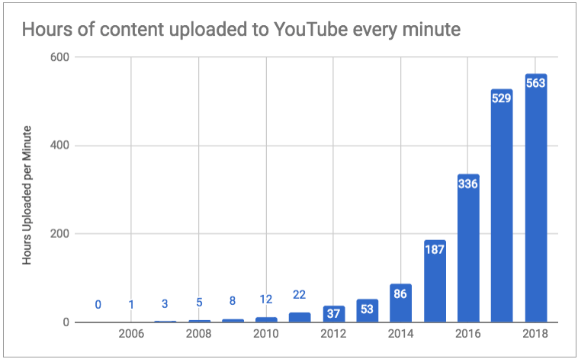

Slide 4
Proposed Solution
We will develop an algorithm to streamline and automate the process of transcribing and summarizing speech in TED talks using IBM Watson and natural language processing (NLP).

Slide 5
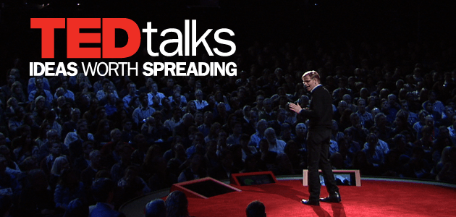
Why start with TED talks?
Monologue
avoid identifying speakers and interactions

